Slide 1
10.009 Digital World
Week 6
Man, Geok See

Slide 2
Topics
File input / output
Compound data type: string

Slide 3
Reading data from file
Example: write a program to read the data from the a file data1.txt and compute the average
  First, need to know the file format: structure of the text
Open the file with ‘open’
  File name, string ‘r’ to open the file for reading, ‘w’ to open the file for writing
  Return a file object referred by the variable infile
data1.txt:
21.8
18.1
19
23
26
17.8
infile = open(‘data1.txt’, ‘r’)
lines = infile.readlines()
infile.close()

Slide 4
Reading data from file
lines = infile.readlines()
Read all lines in a single function call
Return a list of strings, each string is one line
Character ‘\n’ means “carriage return” (has nothing to do with return statement in a function)
Activity: complete the code to compute the average of the data in the file
21.8
18.1
19
23
26
17.8
>>> print lines
['21.8\n', '18.1\n', '19\n', '23\n', '26\n', '17.8']

Slide 5
Reading data from file
Activity: complete the code to compute the average of the data in the file
infile = open('data1.txt', 'r')
lines = infile.readlines()
mysum=0
for x in lines:
y = float(x)
mysum += y
print float(mysum) / len(lines)
infile.close()

Slide 6
Reading data from file
With header
Returns a string containing the text at the current line
Empty line: ‘\n’
End of file: ‘’ (empty string)
infile = open('data1.txt', 'r')
line = infile.readline()
lines = infile.readlines()
mysum=0
for x in lines:
y = float(x)
mysum += y
print float(mysum) / len(lines)
infile.close()
#mid term exam score
21.8
18.1
19
23
26
17.8
line = infile.readline()

Slide 7
Reading data from file
Activity: Use readline() and while loop to compute the average

Slide 8
Reading data from file
Activity: Use readline() and while loop to compute the average
infile = open('data1.txt', 'r')
line = infile.readline()
line = infile.readline()
mysum=0
cnt=0
line=infile.readline()
while line:
y = float(line)
mysum+=y
cnt +=1
line=infile.readline()
print float(mysum) / cnt

Slide 9
read2columns(f)
Hint: s.split() will split the string into words (separated by blanks or any other sequence of characters you have defined)
  Return a list of strings (of words)
>>> s='too much homework'
>>> a = s.split()
>>> a
['too', 'much', 'homework']

Slide 10
Write to a file
File writing is simple: collect the text you want to write in one or more strings and, for each string, call write(string)
outfile=open('ofile.txt', 'w')
outfile.write('hello')
outfile.write('student')
outfile.close()

Slide 11
Manipulate String
Indexing, slicing, addition, immutability
>>> s= 'i like programming'
>>> s[4]
'k'
>>> s[-1]
'g'
>>> len(s)
18
>>> s[2:5]
'lik'
>>> y = s+ ' very much'
>>> y
'i like programming very much'
>>> y[0]='w'
Traceback (most recent call last):
File "<pyshell#47>", line 1, in <module>
y[0]='w'
TypeError: 'str' object does not support item assignment
>>> #string is immutable (constant)

Slide 12
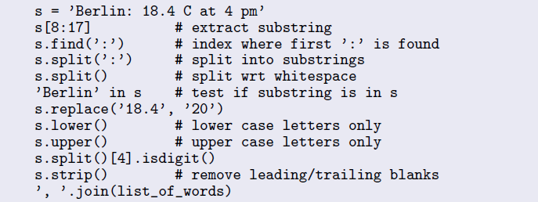
Manipulate String
>>> help(str)

Slide 13
reverse(s)
Hint: check what is range(10,1,-1)?

